Slide 1
INVESTIGATING USER RESISTANCE TO IS IMPLEMENTATION:A STATUS QUO BIAS PERSPECTIVE
NAZLI ZEYNEP BOZDEMİR
e217416

Slide 2
Contents
Introduction
Theoretical Background & Framework
Technology acceptance
User Resistance
Status Quo Bias Theory
Integrative Framework
Model Hypotheses
Research Methodology
Target Organization and System
Instrument Development
Data collection
Data Analysis and Results
Discussion and Implications
conclusion

Slide 3
Introduction
In response to the changes, users may resist the new IS and cause delays in the project duration budget overruns, and underutilization of the new system
Objective of this study is to derive and empirically test a theoretically grounded model of such factors leading to user resistance
Focus: pre-implementation stage
Authors have added the concept of status quo bias to the explanation of user decision making
Aims:
To advance the theoretical understanding of user resistance to new IS implementations
To offer organizations practical insights for managing user resistance

Slide 4
Theoretical Background & Framework
Technology acceptance
User Resistance
Status Quo Bias Theory
Integrative Framework

Slide 5
Technology acceptance
When a new information system is implemented, users may decide to adopt or resist it based on the evaluation of change associated with the system
For this reason, authors have leveraged the technology acceptance literature in examining user resistance
The TAM posits that two beliefs (usefulness and ease of use) predict an individual’s technology usage intention
The TPB is considered as a comprehensive foundation to explain the major influences on acceptance behavior
UTAUT attempts to unify previously identified antecedents of technology acceptance

Slide 6
User Resistance
User resistance in IS research has been conceptualized as an adverse reaction or the opposition of users to perceived change related to a new IS implementation
The article defines user resistance as opposition of a user to change associated with a new IS implementation
Among the theory-driven studies, the closest in objective to their study was the equity-implementation model (EIM)
If net inequity is perceived, users would be resistant to the change

Slide 7
Status Quo Bias Theory
Status quo bias theory aims at explaining people’s preference for maintaining their current status or situation:
Rational decision making
Transition costs
Uncertainty costs
Cognitive misperceptions
Psychological commitment
Sunk costs
Social norms
Control
Notes:
(önce slide) status quo bias explanations are discussed in terms of three main categories: rational decision making, cognitive misperceptions, and psychological commitment.
Rational decision making implies an assessment of relative costs and benefits of change (i.e., net benefits) before making a switch to a new alternative. Greater costs than benefits lead to status quo bias.
transition costs are the costs incurred in adapting to the new situation.
Uncertainty costs, representing the psychological uncertainty or perception of risk associated with the new alternative, can also cause status quo bias. Switching to a new IS can inflict uncertainty costs on users because they may be unsure and anxious about the resulting changes.
The cognitive misperception of loss aversion also explains status quo bias. Loss aversion is a psychological principle that has been observed in human decision making in that losses loom larger than gains in value perception.
The third category of status quo bias explanations is based on psychological commitment. Three main factors contribute to psychological commitment: sunk cost, social norms, and efforts to feel in contro
Sunk costs refer to previous commitments, which cause reluctance to switch to a new alternative
Social norms refer to the norms prevailing in the work environment about the change, which can either reinforce or
weaken an individual’s status quo bias.
Finally, Efforts to feel in control stem from individuals’ desires to direct or determine their own situation

Slide 8
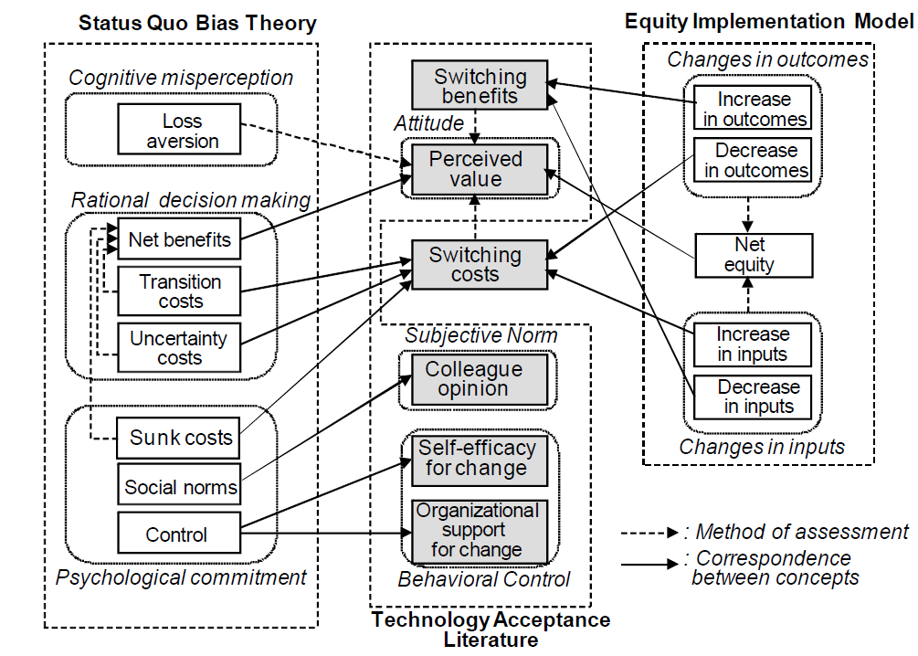
Integrative Framework
Authors made use of the TPB to integrate and add to SQB theory and EIM in order to explain user resistance prior to a new IS implementation
Notes:
figure 1 shows how the technology acceptance literatüre, status quo bias theory, and EIM concepts correspond to authors model constructs.

Slide 9
Model Hypotheses

Slide 10
Perceived value has a negative effect on user resistance
Switching costs have a positive effect on user resistance.
Switching costs have a negative effect on perceived value.
Switching benefits have a positive effect on perceived value.
Self-efficacy for change has a negative effect on user resistance.
Self-efficacy for change has a negative effect on switching costs.
Organizational support for change has a negative effect on user resistance.
Organizational support for change has a negative effect on switching costs.
Favorable colleague opinion has a negative effect on user resistance.
Favorable colleague opinion has a negative effect on switching costs.
Favorable colleague opinion has a positive effect on switching benefits.

Slide 11
Research Methodology
Target Organization and System
Instrument Development
Data collection

Slide 12
Target Organization and System
The target organization is a major IT service company with more than 5,800 employees. The company
Provides IT services to client organizations, including IS consulting, IT solutions, and IS development
Deployed a new enterprise system called “New Office Plus” (NOP) which took about 12 months to customize
Redesigned and automated its workflows and integrated the workflows with the relevant application systems
When the system was rolled out, there were numerous integration errors and frequent system breakdowns
Subsequently, the system stabilized and was gradually accepted by users

Slide 13
Instrument Development
Authors have developed the measurement items for switching benefits based on the definition and by referring to the items of relative advantage
The degree of resistance is considered to increase from covert passive to overt active behaviors
four items representing resistance behavior:
“not comply with” (passive and covert),
“not cooperate” (active and covert),
“do not agree” (passive and overt),
“oppose” (active and overt)

Slide 14
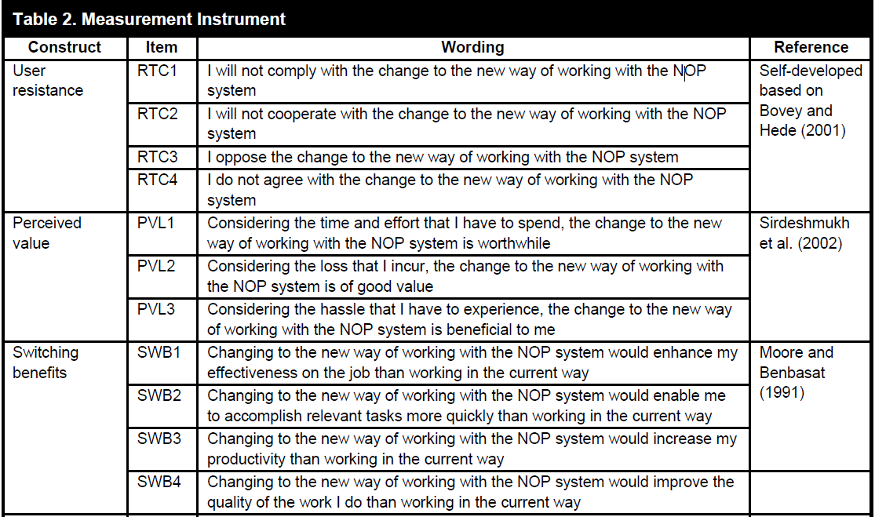
Notes:
The final version of the questionnaire is shown in Table 2.

Slide 15
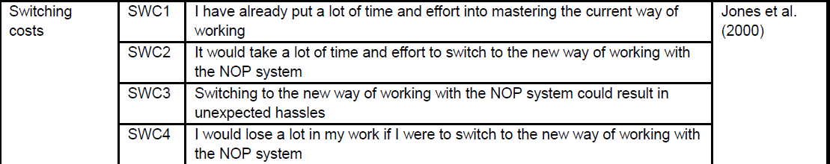
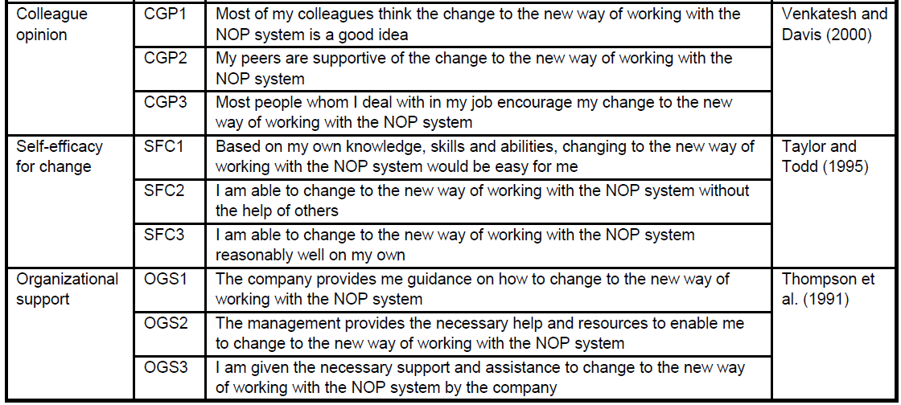

Slide 16
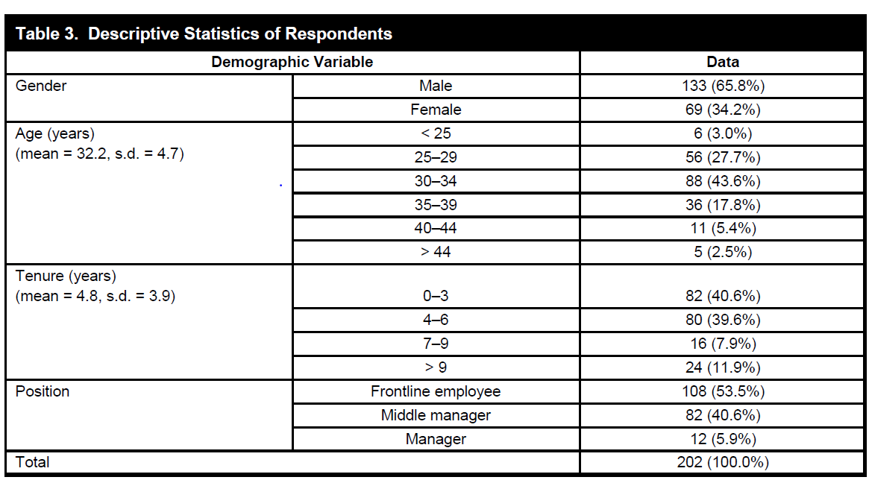
Data collection
Total of 202 complete and valid responses (40.4 percent of response rate) were collected across 10 business units
Notes:
(önce burası) authors have collected data from the employees during the last five days before the NOP was put into operation They have also conducted interviews with users and the project manager They randomly selected 500 employees across different business units and different organizational positions to whom they distributed the survey questionnaires
Total of 202 complete and valid responses (40.4 percent of response rate) were collected across 10 business units
(finance, human resource, procurement, research, consulting, manufacturing business, financial business, public business, IT solution, and training center)

Slide 17
Data Analysis & Results

Slide 18
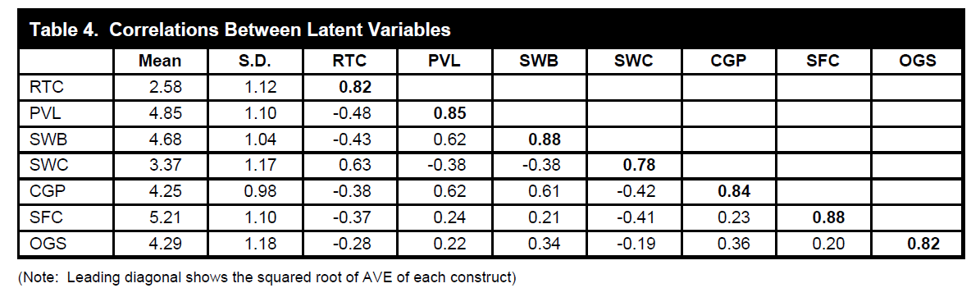
Instrument Validation
To validate the survey instrument, authors have assessed its convergent and discriminant validity
They first performed confirmatory factor analysis (CFA) using LISREL
Then, they assessed the discriminant validity of the measurement model
Notes:
(önce slide) As shown in Table 4, the square root of AVE for each construct (diagonal term) exceeded the correlations
between the construct and other constructs (off-diagonal terms). Hence, discriminant validity of the instrument was established.

Slide 19
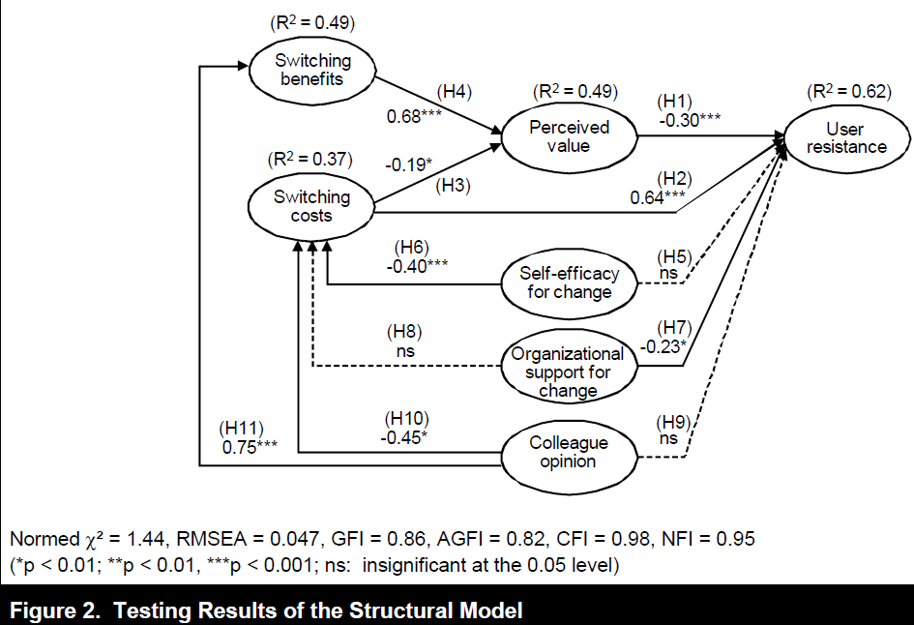
Hyphothesis Testing
After establishing the validity of the measurement instrument, they examined the structural model using LISREL
Notes:
The results of testing the structural model are shown in Figure 2. All the fit indices meet the recommended guidelines except for GFI (0.86), which is close to the threshold. The structural model has an adequate fit with the data.
The results indicate that perceived value (H1), switching costs (H2), and organizational support for change (H7) had significant
effects on user resistance, explaining 62 percent of its variance. Switching costs (H3) and switching benefits (H4) had significant effects on perceived value, explaining 49 percent of its variance. Self-efficacy for change (H6) and colleague opinion (H10) had significant effects on switching
costs, explaining 37 percent of its variance. Colleague opinion (H11) also had a significant effect on switching benefits, explaining 49 percent of its variance. However, 3 hypotheses (H5, H8, and H9) out of 11 were not supported. They additionally included four control variables (gender, age, tenure, and
position) but none of them had a significant effect on user resistance.

Slide 20
Discussion & Implications

Slide 21
Discussion of Findings
There are several significant findings from this study:
It proved that switching costs increase user resistance both directly and indirectly through their effect on perceived value
It showed that colleague opinion toward change reduces switching costs and increases switching benefits
However, the model has three insignificant relationships:
Self-efficacy for change has no direct impact on user resistance
It found that organizational support for change has no effect on switching costs, but reduces user resistance directly
Colleague opinion has no direct impact on user resistance

Slide 22
Theoretical Implications
This research offers several implications and contributions to theory:
It combines technology acceptance and resistance theories to examine how users assess overall change related to a new IS
Combines technology acceptance and user resistance theories along with the status quo bias theory
Has a theoretical implication in terms of status quo bias theory

Slide 23
Practical Implications
The study offer suggestions to management about how to alleviate user resistance in IS implementation:
Management should be aware of the critical effect of switching costs on user resistance
Management should aim to increase the perceived value of change and organizational support for change to reduce user resistance

Slide 24
Conclusion
This study develops a theoretical model for user resistance by:
Combining technology acceptance and user resistance theories
Bringing the status quo bias perspective to the forefront
Highlights the significance of switching costs as a key determinant of user resistance
Identifies colleague opinion and self-efficacy for change as antecedents that reduce switching costs
The findings offer organizations suggestions for managing user resistance with the aim of mitigating the failure of IS implementations

Slide 25
Thank you…

